Slide 1
Hidden Surface Removal

Slide 2
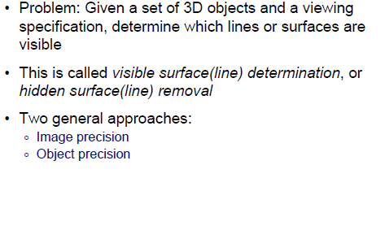
Visible Surface

Slide 3
Invisible Primitives
Why might a polygon be invisible?
  Polygon outside the field of view
  Polygon is backfacing
  Polygon is occluded by object(s) nearer the viewpoint
For efficiency reasons, we want to avoid spending work on polygons outside field of view or backfacing
For efficiency and correctness reasons, we need to know when polygons are occluded

Slide 4
HSR algo classes
Three classes of algorithms
  “Conservative” visibility testing: only trivial reject – does not give final answer!
    e.g., back-face culling, canonical view volume clipping, spatial subdivision
    have to feed results to algorithms mentioned below
  Image precision – resolve visibility at discrete points in image
    sample model, then resolve visibility – i.e., figure out which objects it makes sense to compare with
    e.g., ray tracing, or Z-buffer and scan-line algo.
  Object precision – resolve for all possible view directions from a given eye point
    irrespective of view direction or sampling density
    resolve visibility exactly, then sample the results
    e.g., 3-D depth sort, BSP trees

Slide 5
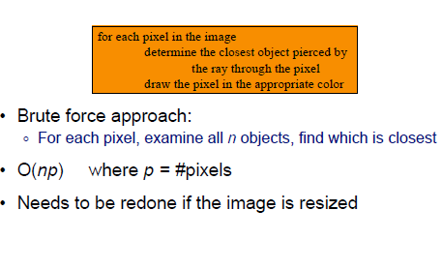
Image Precision

Slide 6
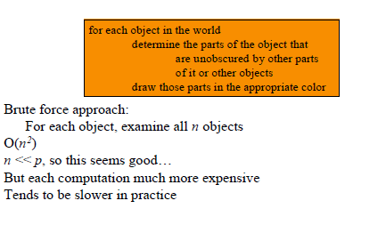
Object Precision

Slide 7
Outline
Back- Face Culling
z- Buffer (Depth- Buffer)
Depth- Sort
BSP- Tree
Scanline Algorithm

Slide 8
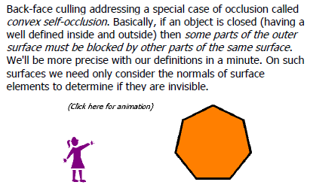
Back Face Culling

Slide 9
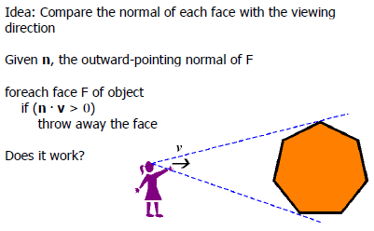
Removing Back Faces

Slide 10
Back-Face Culling
On the surface of a closed manifold, polygons whose normals point away from the camera are always occluded:
Plane Normal . (Point on plane - COP) > 0 -----→ Backface

Slide 11
Back-Face Culling
On the surface of a closed manifold, polygons whose normals point away from the camera are always occluded:

Slide 12
Back-Face Culling - Problems
On the surface of a closed manifold, polygons whose normals point away from the camera are always occluded:
Note: backface culling
alone doesn’t solve the
hidden-surface problem!

Slide 13
Back-Face Culling - Problems
one polyhedron may obscure another

Slide 14
Back-Face Culling - Advantages
On average, approximately one-half of a polyhedron’s polygons are back-facing.
Back-Face culling halves the number of polygons to be considered for each pixel in an image precision algorithm.

Slide 15
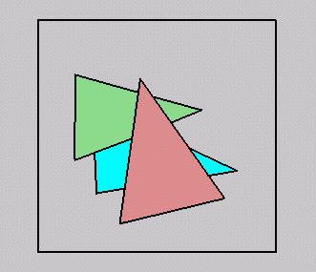
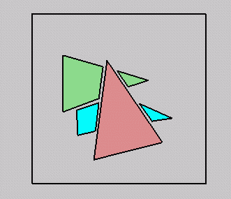
Occlusion
For most interesting scenes, some polygons will overlap:
To render the correct image, we need to determine which polygons occlude which

Slide 16
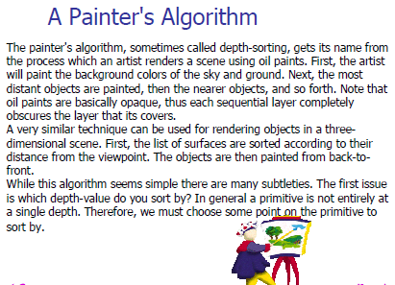
Painters Algorithm

Slide 17
Painter’s Algorithm
Simple approach: render the polygons from back to front, “painting over” previous polygons:
  Draw blue, then green, then pink
Will this work in general?

Slide 18
Painter’s Algorithm: Problems
Intersecting polygons present a problem
Even non-intersecting polygons can form a cycle with no valid visibility order:

Slide 19
Z-Buffer – Image Precision
  Requires two “buffers”
    Intensity Buffer
    —our familiar RGB pixel buffer
    —initialized to background color
    Depth (“Z”) Buffer
    —depth of scene at each pixel
    —initialized to far depth
  Polygons are scan-converted in arbitrary order. When pixels overlap, use Z-buffer to decide which polygon “gets” that pixel

Slide 20
Z-Buffer
Algorithm:
Initialize:
  Each z- buffer cell ⇐ Max z value
  Each frame buffer cell ⇐ background color
For each polygon:
  Compute z( x, y), polygon depth at the pixel (x, y)
  If z( x, y) < z buffer value at pixel (x, y) then
    z buffer( x, y) ⇐ z( x, y)
    pixel( x, y) ⇐ color of polygon at (x, y)

Slide 21
Z-Buffer
255 | 255 | 255 | 255 | 255 | 255 | 255 | 255
255 | 255 | 255 | 255 | 255 | 255 | 255 | 255
255 | 255 | 255 | 255 | 255 | 255 | 255 | 255
255 | 255 | 255 | 255 | 255 | 255 | 255 | 255
255 | 255 | 255 | 255 | 255 | 255 | 255 | 255
255 | 255 | 255 | 255 | 255 | 255 | 255 | 255
255 | 255 | 255 | 255 | 255 | 255 | 255 | 255
255 | 255 | 255 | 255 | 255 | 255 | 255 | 255
127 | 127 | 127 | 127 | 127 | 127 | 127
127 | 127 | 127 | 127 | 127 | 127
127 | 127 | 127 | 127 | 127
127 | 127 | 127 | 127
127 | 127 | 127
127 | 127
127
127 | 127 | 127 | 127 | 127 | 127 | 127 | 255
127 | 127 | 127 | 127 | 127 | 127 | 255 | 255
127 | 127 | 127 | 127 | 127 | 255 | 255 | 255
127 | 127 | 127 | 127 | 255 | 255 | 255 | 255
127 | 127 | 127 | 255 | 255 | 255 | 255 | 255
127 | 127 | 255 | 255 | 255 | 255 | 255 | 255
127 | 255 | 255 | 255 | 255 | 255 | 255 | 255
255 | 255 | 255 | 255 | 255 | 255 | 255 | 255
+
=
127 | 127 | 127 | 127 | 127 | 127 | 127 | 255
127 | 127 | 127 | 127 | 127 | 127 | 255 | 255
127 | 127 | 127 | 127 | 127 | 255 | 255 | 255
127 | 127 | 127 | 127 | 255 | 255 | 255 | 255
127 | 127 | 127 | 255 | 255 | 255 | 255 | 255
127 | 127 | 255 | 255 | 255 | 255 | 255 | 255
127 | 255 | 255 | 255 | 255 | 255 | 255 | 255
255 | 255 | 255 | 255 | 255 | 255 | 255 | 255
128
127 | 127
120 | 120 | 120
115 | 115 | 115 | 115
115 | 115 | 115 | 115 | 115
127 | 127 | 127 | 127 | 127 | 127 | 127 | 255
127 | 127 | 127 | 127 | 127 | 127 | 255 | 255
127 | 127 | 127 | 127 | 127 | 255 | 255 | 255
127 | 127 | 127 | 127 | 255 | 255 | 255 | 255
127 | 127 | 127 | 255 | 255 | 255 | 255 | 255
120 | 120 | 120 | 255 | 255 | 255 | 255 | 255
115 | 115 | 115 | 115 | 255 | 255 | 255 | 255
115 | 115 | 115 | 115 | 115 | 255 | 255 | 255
+
=
Above: example using integer Z-buffer with near = 0, far = 255

Slide 22
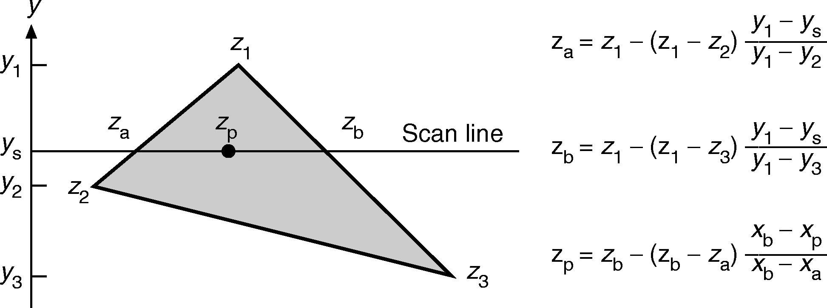
Computing Z values
Interpolation along scan line
Interpolation along edge
How do we compute it efficiently?
  Answer is simple: do it incrementally!
  Remember scan conversion/polygon filling? As we move along Y-axis, track x position where each edge intersects scan-line
  do same thing for z coordinate using “remainder” calculations with y-z slope
  Once we have z_{a} and z_{b} for each edge, can incrementally calculate z_{p} as we scan. Did something similar with calculating color per pixel in Gouraud shading

Slide 23
Z-Buffer: Advantages
  Simplicity lends itself well to hardware implementations: FAST
    used by all graphics cards
  Polygons do not have to be compared in any particular order: no presorting in z necessary, big gain!
  Only consider one polygon at a time
  Z-buffer can be stored with an image; allows you to correctly composite multiple images (easy!) without having to merge models (hard!)
  Can be used for non-polygonal surfaces

Slide 24
Z-Buffer: Disadvantages
  A pixel may be drawn many times
    A rough front to back depth sort can be performed
  High amount of memory required due to Z buffer
    Image can be scan converted in strips, at the expense of multiple passes over the objects
  Lower precision for higher depth
    Do not have enough precision for objects with millimeter detailed, positioned at kilometer apart
    Shared edges of polyhedron where some visible pixels come from one polygon, and other come from neighbor

Slide 25
Scan-Line Algorithm
Image precision algorithm
Renders scene scan line by scan line
Maintain various lists
  Edge Table
  Active Edge Table
  Polygon Table
  Active Polygon Table

Slide 26
Scan-Line Algorithm
Edge Table (ET)
  Horizontal edges are ignored
  Sorted into buckets based on each edge’s smaller y-coordinate
  Within buckets, edges are ordered by increasing x-coordinate of their lower end point
Polygon Table (PT)
x_{at ymin}
y_{max}
Δx
ID
Δx=Δy/m → used in stepping from one scan line to next
Δy=1
ID
Plane eqn.
Shading Info
in-out
Boolean Flag
Used during scan line processing
Initial value = 0

Slide 27
Scan-Line Algorithm
Active Edge Table (AET)
  Stores the list of edges intersecting current scanline in increasing order of current x-coordinate
Active Polygon Table (APT)
  At each x-scan value this table contains the list of polygons whose in-out flag is set to true
y_{max}
x_{A}
Δx

Slide 28
Scan-Line Algorithm
y
B
E
γ+2
γ+1
γ
D
C
β
F
α
A
ET contents
AB AC DF EF CB DE
x
PT contents
ABC
DEF

Slide 29
Scan-Line Algorithm
y
B
E
γ+2
γ+1
γ
D
C
β
F
α
A
x
AET contents
Scan line Entries
α AB AC
β AB AC FD FE
γ, γ+1 AB DE CB FE
γ+2 AB CB DE FE
y_{max}
x_{A}
Δx

Slide 30
Scan-Line Algorithm
Initialization
  Initialize the AET to empty
  Initialize each screen pixel to bk-color
  Set y to the first nonempty cell value in edge table

Slide 31
Scan-Line Algorithm
For each scan line y do
  AET ← AET∪ Edges from ET that are in current scanline
  sort AET in order of increasing x_{A}
  For each edge e (except last one) in AET do
    invert in-out flag of the polygon that contains e
    Update APT
    Determine polygon p in APT with smallest z value at (e.x_{A}, y)
    The pixels from e upto next edge in AET are set to the color of p
  AET ← AET - Edges from ET with
  y_{max} = y
  for each edge e in AET do
  e.x_{A} = e.x_{A} + e.Δx
  Sort AET on x_{A}

Slide 32
Simulation
y
B
E
γ+2
Draw up to next edge in AET
γ+1
Toggle:
ABC.inout=0→1
γ
D
C
β
Draw
Toggle:
ABC.inout=1→0
F
α
A
x
AET
AB
AC
APT
ABC

Slide 33
Simulation
y
B
E
Toggle:
ABC.inout=0→1
γ+2
γ+1
Draw
Toggle:
ABC.inout=1→0
γ
Draw
D
C
Toggle:
DEF.inout=0→1
β
F
α
Toggle:
DEF.inout=1→0
A
x
AET
AB
AC
DF
EF
APT
ABC
DEF

Slide 34
Simulation
y
B
E
Draw up to next edge in AET
Toggle:
ABC.inout=0→1
γ+2
Draw
Draw
γ+1
Toggle:
DEF.inout=0→1
γ
D
C
Draw with selected intensity up to next edge in AET
β
Toggle:
ABC.inout=1→0
F
α
Toggle:
DEF.inout=1→0
Find out the near most polygon
from APT, select that’s intensity
A
x
AET
AB
DE
BC
EF
APT
ABC
DEF

Slide 35
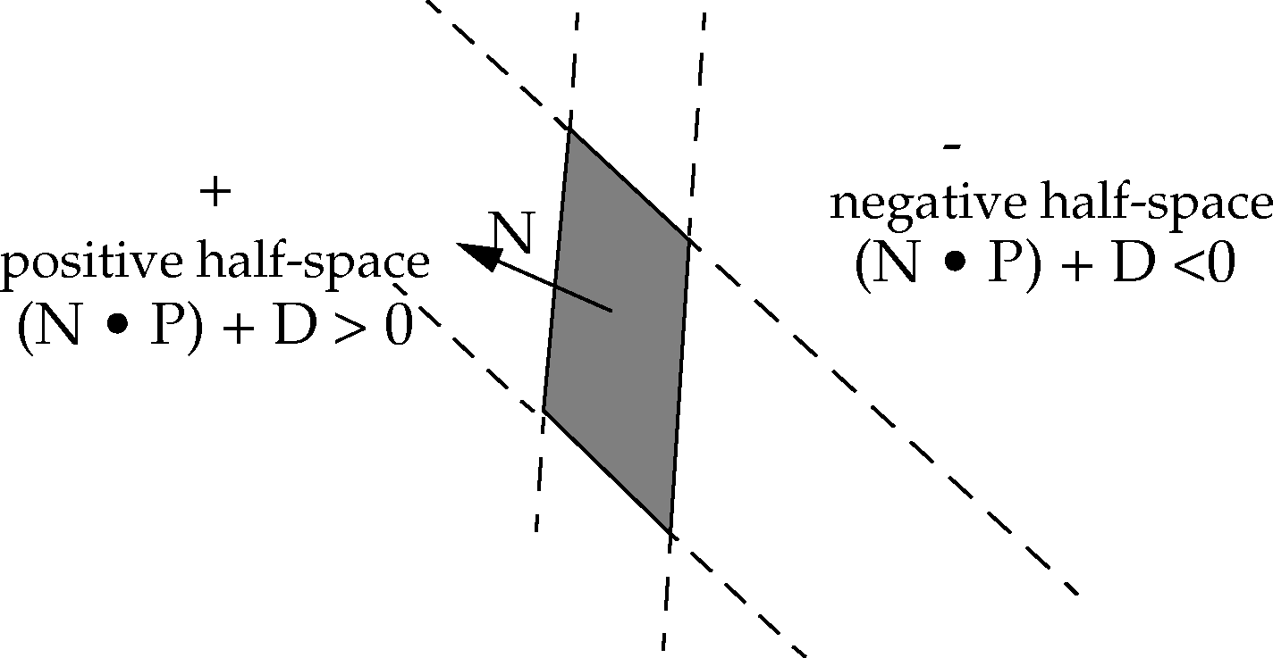
Plane-Half Space interpretation
  A plane can be defined by a normal N and any point, P₀, on the plane:
    plane satisfied by N_{x}P_{x} + N_{y}P_{y} + N_{z}P_{z}+ D= 0
    pick another point, P; then we can say N •(P – P₀) = 0
    notice that –N •P₀ is constant; let’s call it D
    solve for D using any point on the plane.
  Plane divides all points into two half-spaces
    (N • P) + D = 0, P is on plane
    (N • P) + D > 0, P is in positive half-space
    (N • P) + D < 0, P is in negative half-space
  Polygon faces away for eye points in negative half-space
    if (N • Eye) + D < 0, discard

Slide 36
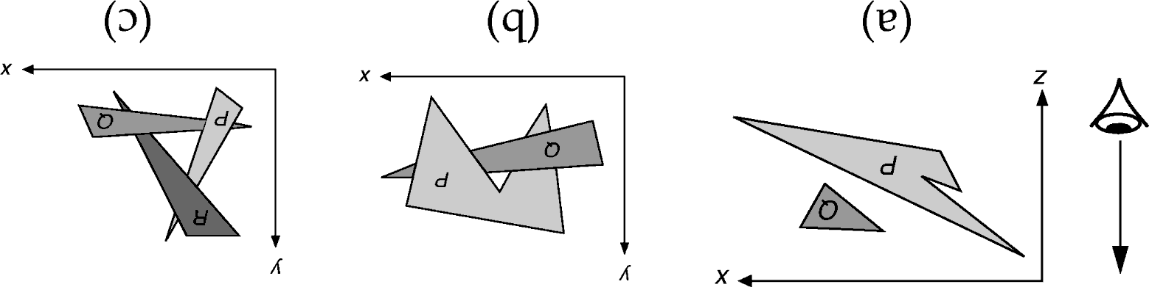
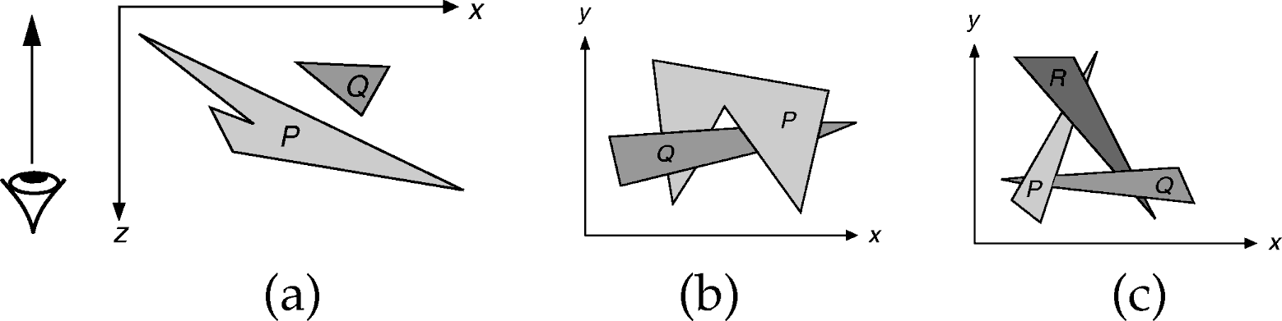
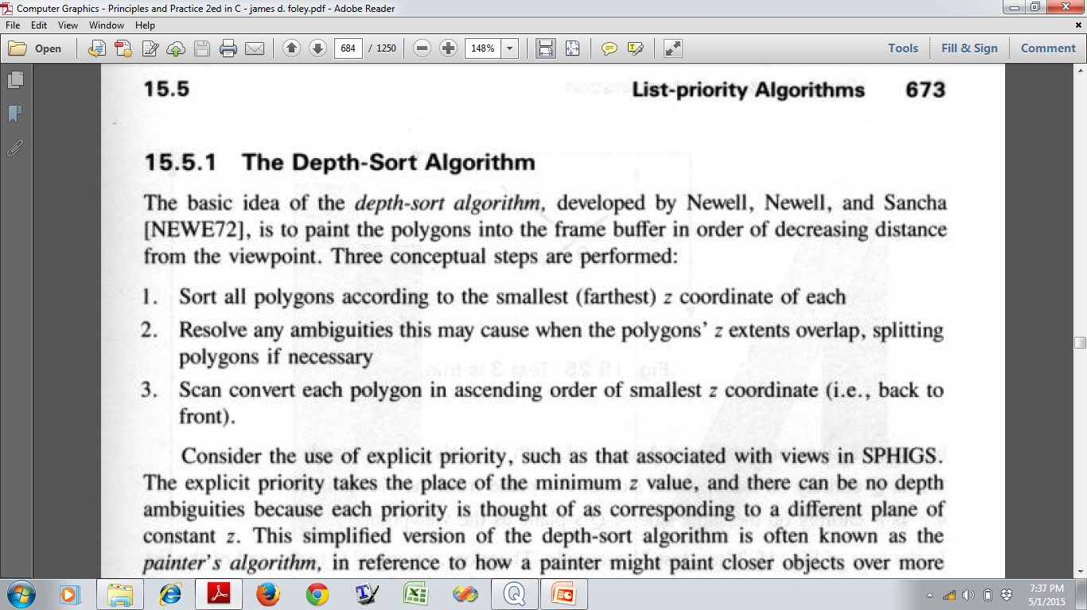
Depth-Sort Algorithm

Slide 37
Depth-Sort Algorithm
Select P → Polygon at the far end of the sorted list
Before scan converting P,
  Test against each polygon Q with which it’s
  z-extent overlaps
  If P cannot obscure any such Q, then P can be
  scan converted
5 tests are performed in successive order

Slide 38
Depth-Sort Algorithm
Checking 5 tests to see whether polygon P obscures polygon Q
  Are the x-extents of P and Q disjoint?
  Are the y-extents of P and Q disjoint?
  Is P entirely on the opposite side of Q’s plane from the eye?
  Is Q entirely on the same side of P’s plane as the eye?
  Are the projections of P and Q on the screen are disjoint?

Slide 39
Checking 5 tests to see whether polygon P obscures polygon Q
  Are the x-extents of P and Q disjoint?
  Are the y-extents of P and Q disjoint?
x
z
NO
YES

Slide 40
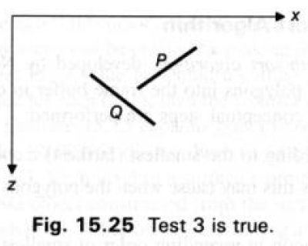
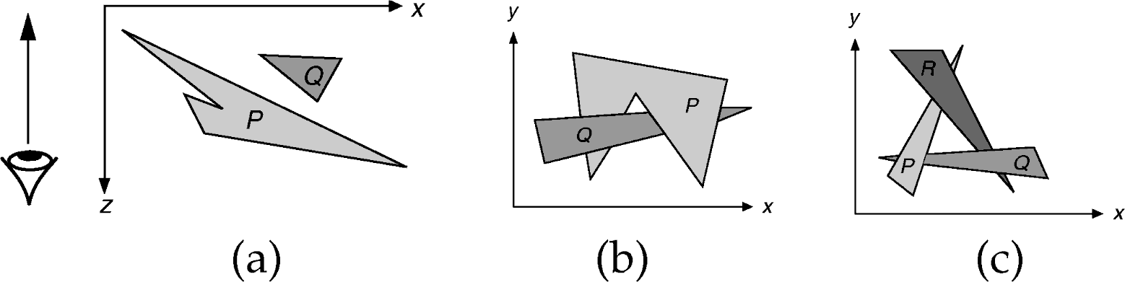
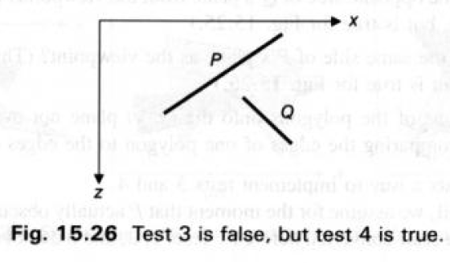
Checking 5 tests to see whether polygon P obscures polygon Q
  Is P entirely on the opposite side of Q’s plane from the viewpoint?
  Is Q entirely on the same side of
  P’s plane as the eye?
NO
YES
YES

Slide 41
Checking 5 tests to see whether polygon P obscures polygon Q
  Are the projections of P and Q on the screen are disjoint?
y
x
NO
YES

Slide 42
Depth-Sort Algorithm
Checking 5 tests to see whether polygon P obscures polygon Q
As soon as a test returns TRUE → P does not obscure Q
  So P can be scan converted before Q
  If there are other polygons whose z extent overlaps P, then repeat the 5 tests for those also
If all tests return FALSE → P obscures Q
  Can we scan convert Q before P?
  3'. Is Q entirely on the opposite
  side of P’s plane from the eye?
  4'. Is P entirely on the same side
  of Q’s plane as the eye?
  -- If returns YES → Q becomes the new P
  and included at the end of the list
YES

Slide 43
Depth-Sort Algorithm
What if both tests 3’ and 4’ return NO ?
  Q cannot totally obscure P
  So SPLIT (since none obscure other fully)
    Original unsplit polygons are discarded
    Pieces are inserted into the list in proper z order

Slide 44
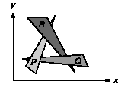
Depth-Sort Algorithm
Special Case:
P, Q, R → any one of them can be inserted at the end of the list to place it in correct order relative to one other polygon, but not two others → results in infinite loop
Solution:
  mark the polygon once it is moved
  to the end of the list
  If 5 tests return NO
    do not try steps 3' and 4’
    Split the polygons and insert the pieces in to the list

Slide 45
Depth-Sort Algorithm
Advantages:
  Fast enough for simple scenes
  Fairly intuitive
Disadvantages
  Slow for even moderately complex scenes
  Hard to implement and debug
  Lots of special cases
    May cause unnecessary split

Slide 46
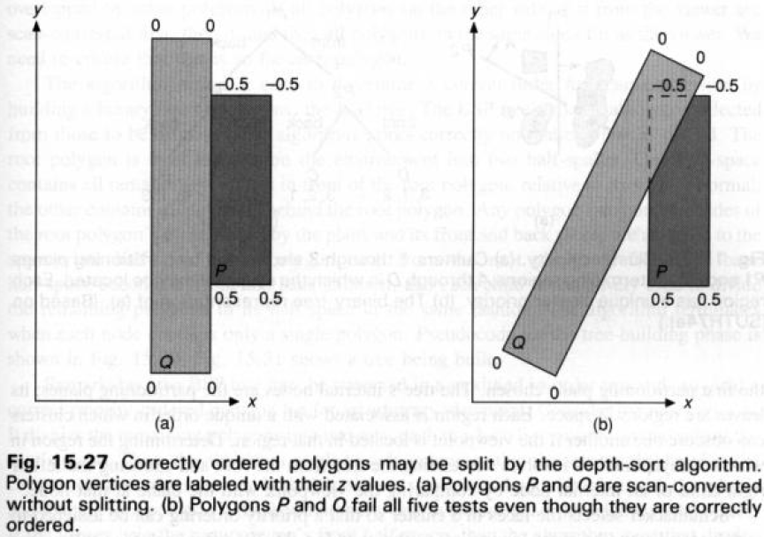
Depth-Sort Algorithm
  Unnecessary Split:

Slide 47
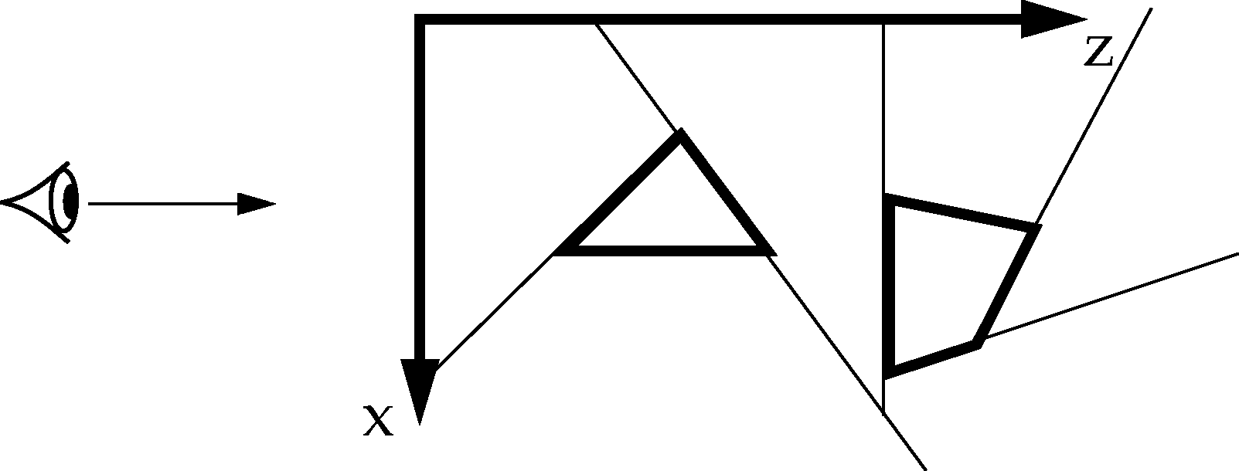
Binary Space Partioning (BSP) Tree
Split space with any line (2D) or plane (3D)
Repetitive subdivision of space to give a draw order
Divide and conquer:
  Select any polygon as root
  Then display all polygons on “far” (relative to viewpoint) side of that polygon, then that polygon, then all polygons on polygon’s “near” side
Runs an initial time and space intensive preprocessing step
  View independent subdivision of the space
Allows a linear time display algorithm that is executed whenever viewing direction change
Suitable for cases where the view point changes but objects remain static

Slide 48
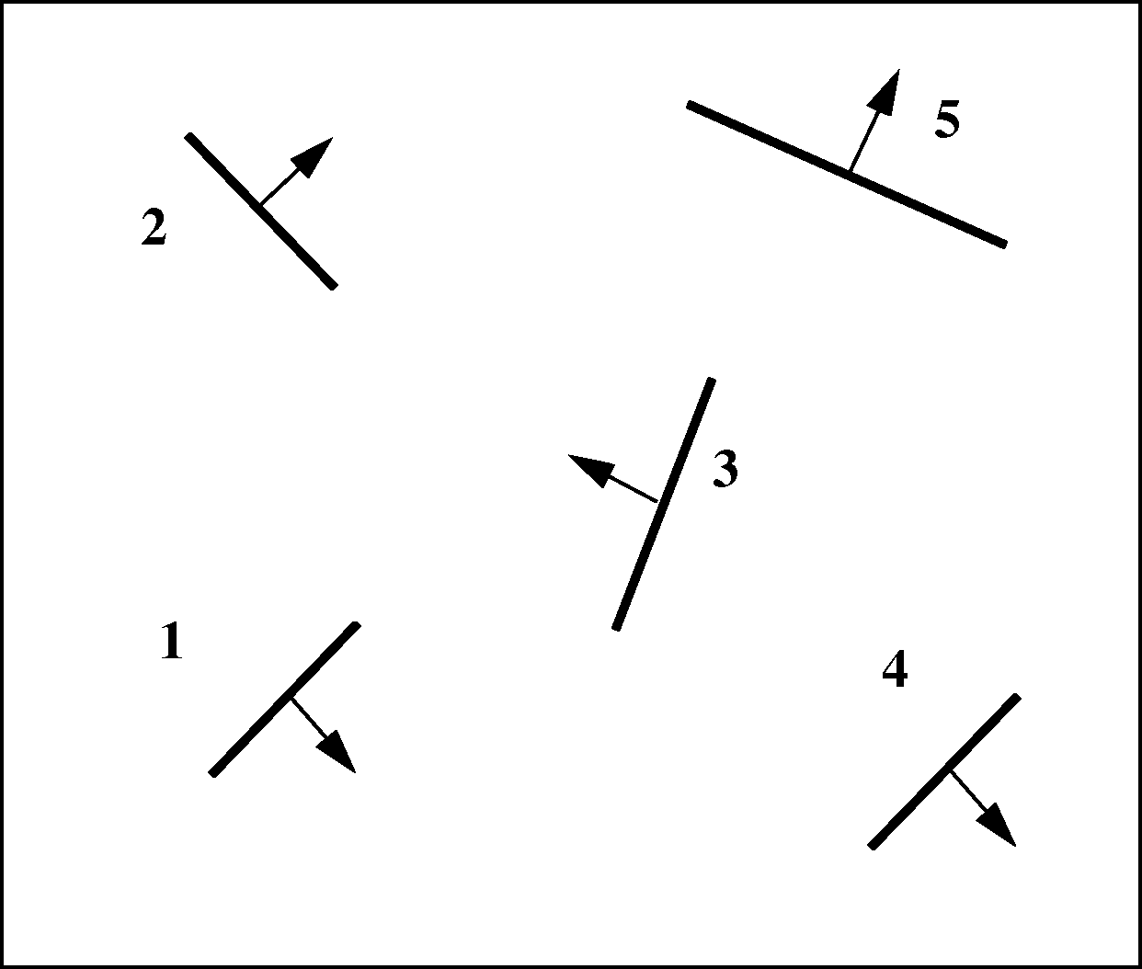
BSP Tree
Perform view-independent step once each time scene changes:
    recursively subdivide environment into a hierarchy of half-spaces by dividing polygons in a half-space by the plane of a selected polygon
    build a BSP tree representing this hierarchy
    each selected polygon is the root of a sub-tree
An example:
Initial Scene

Slide 49
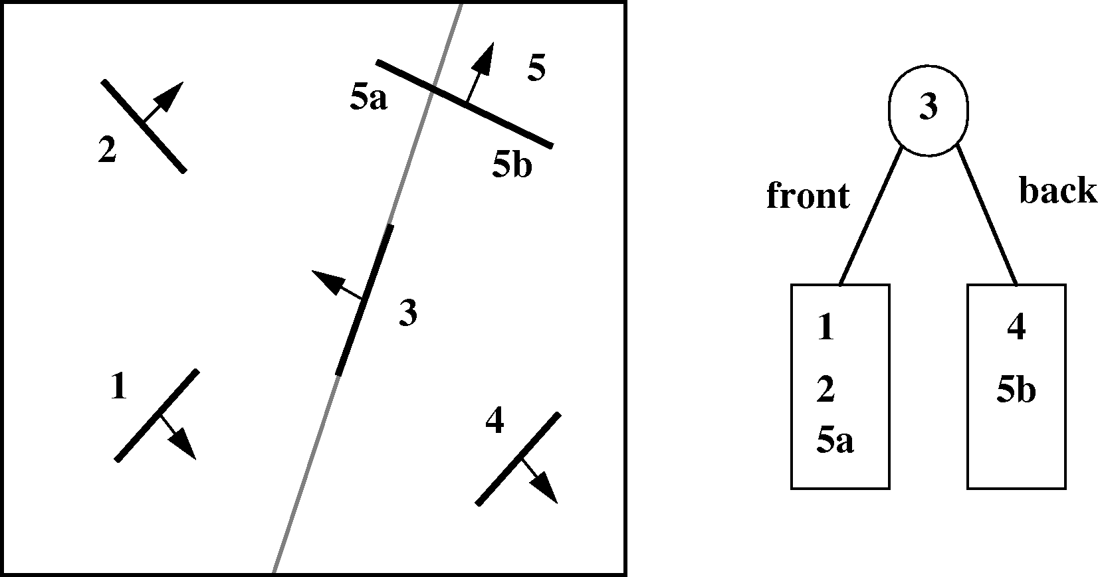
BSP Tree
Step-1: Choose any polygon (e.g., polygon 3) and subdivide others
by its plane, splitting polygons when necessary

Slide 50
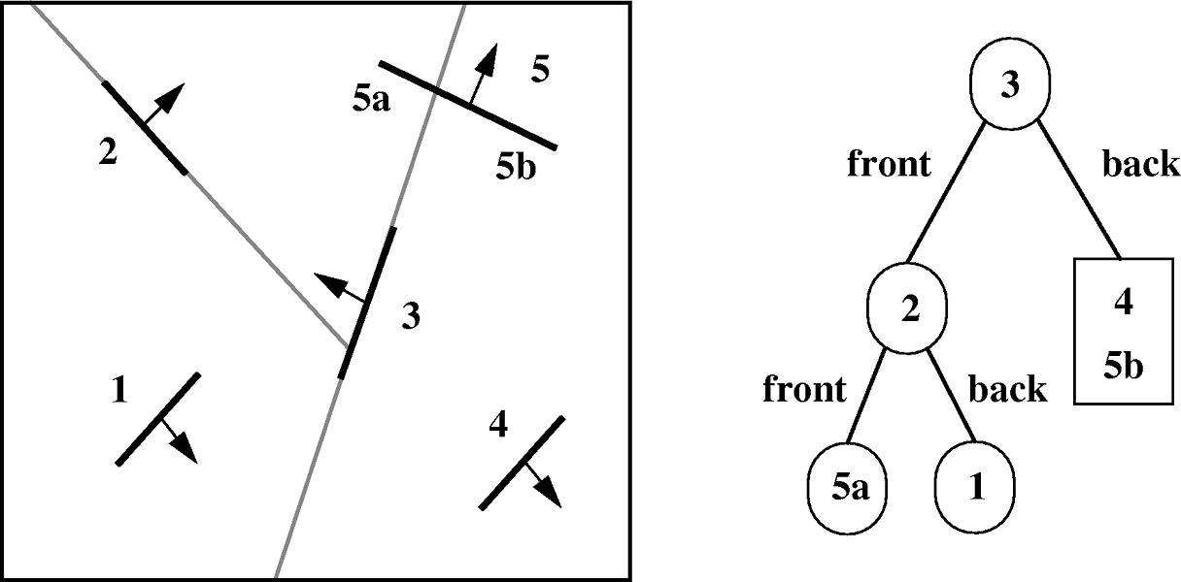
BSP Tree
Step-2: Process front sub-tree recursively

Slide 51
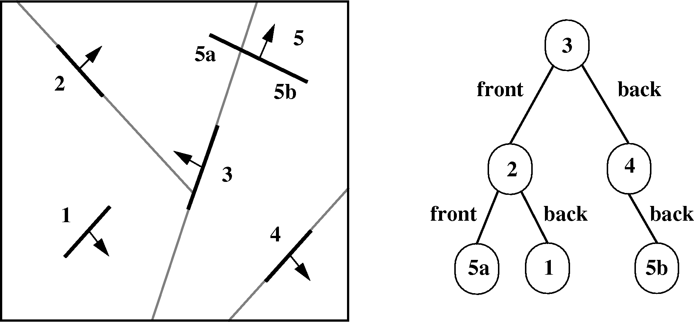
BSP Tree
Step-3: Process back sub-tree recursively

Slide 52
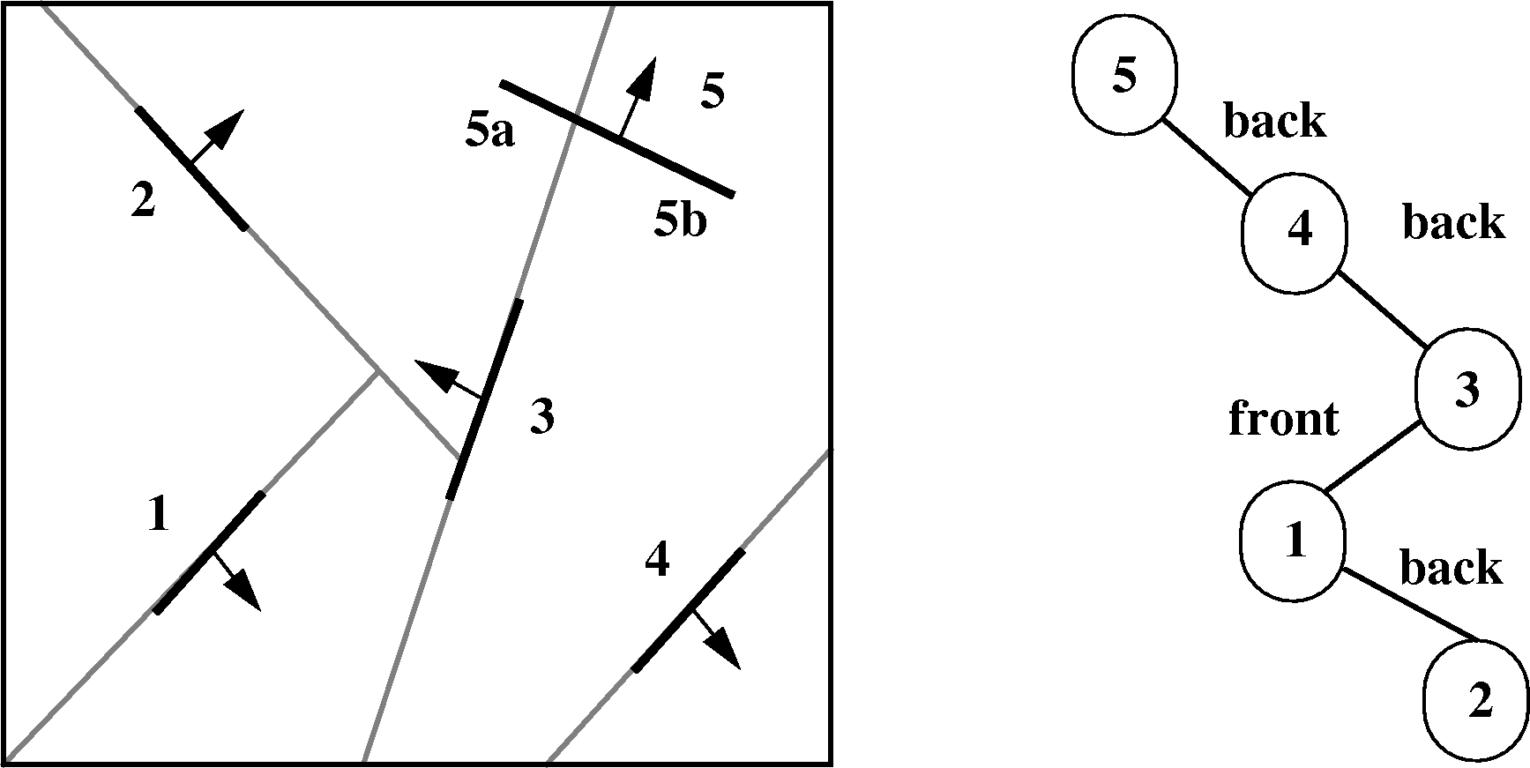
BSP Tree
An alternative BSP tree with polygon 5 at the root

Slide 53
Pseudo code for Building BSP Tree
Pseudocode for Building BSP Tree
typedef struct {
polygon root;
BSP_tree *backChild, *frontChild;
} BSP_tree;
BSP_tree *BSP_makeTree(polygon *polylist)
polygon root, *backList, *frontList, p, backPart, frontPart;
if (polyList == NULL) return NULL;
else
root = BSP_selectAndRemovePoly( &polyList );
backList = frontList = NULL;
for (each remaining polygon p in polylist)
if (polygon p in front of root)
BSP_addToLkist(p, &frontList);
else if (polygon p in back of root)
BSP_addToLkist(p, &backList);
else
BSP_splitPoly( p, root, &fronPart, &backPart);
BSP_addToList(frontPart, &frontList);
BSP_addToList(backPart, &backList);
return BSP_combineTree(BSP_makeTree(frontList), root, BSP_makeTree(backList)

Slide 54
Pseudo code for Building BSP Tree
void BSP_displayTree(BSP_tree *tree) {
if (tree != NULL) {
if (viewer is in front of tree->root) {
/*Display back child, root, and front child */
BSP_displayTree(tree->backChild);
displayPolygon(tree->root);
BSP_displayTree(tree->frontChild);
} else {
/*Display front child, root, and back child */
BSP_displayTree(tree->frontChild);
displayPolygon(tree->root);
BSP_displayTree(tree->backChild);
}
}
}

Slide 55
Display BSP Tree
Given a viewpoint, apply modified in-order tree traversal
If viewer is in the root polygon’s front half space
  Display all the polygons in the root’s rear half space
  Then display the root
  Finally display the polygons
  in its front half space
If viewer is in the root polygon’s
rear half space
  Display all the polygons in the
  root’s front half space
  Then display the root
  Finally display the polygons
  in its rear half space
If viewer is looking along the edge of the root polygon
  Follow any display order provided above

Slide 56

Display BSP Tree
4
5
2
3
6
1

Slide 57
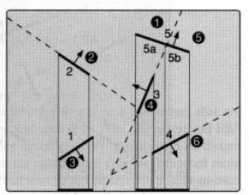
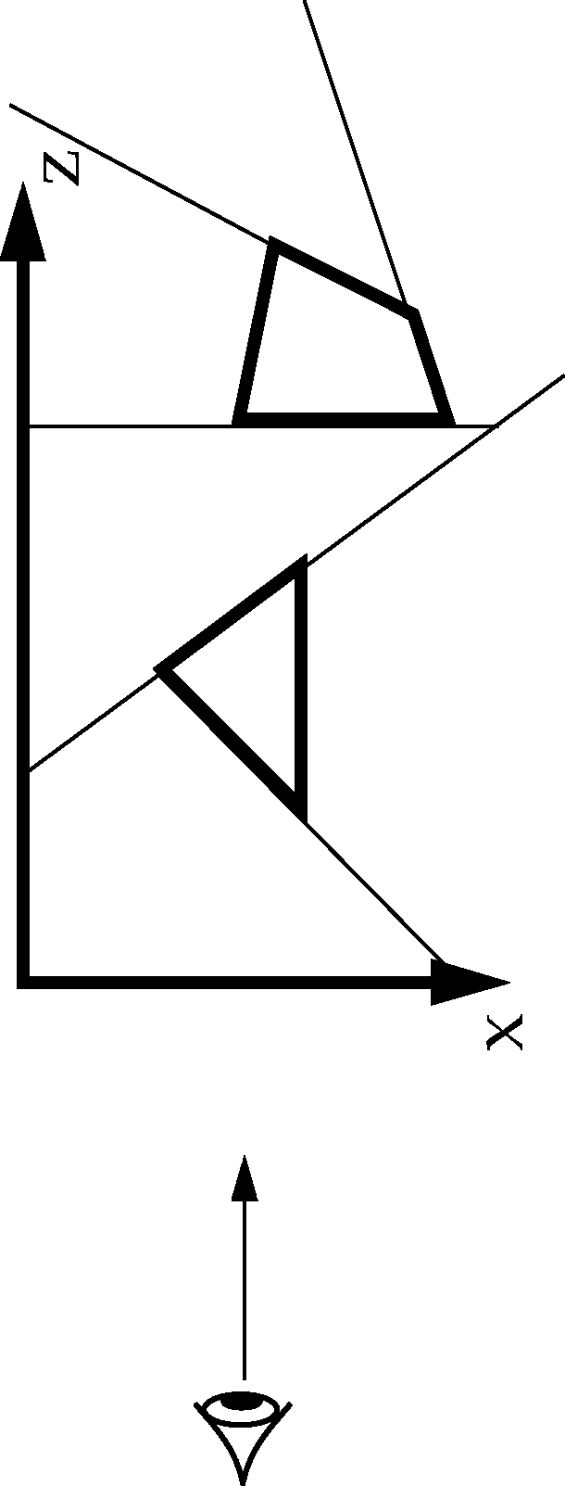
Display BSP Tree

Slide 58
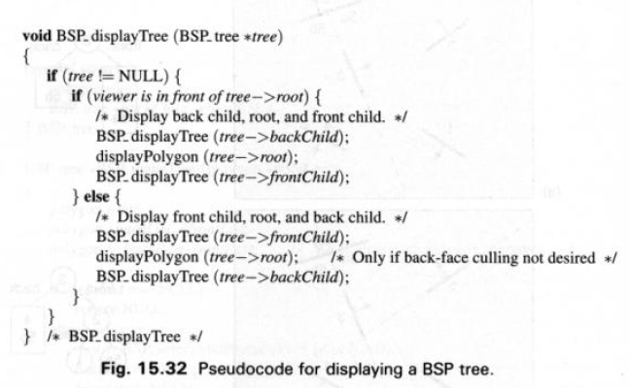
Display BSP Tree

Slide 59
BSP Tree
Painter’s Algorithm with BSP Trees
  Each face has form Ax + By + Cz + D
  Plug in coordinates and determine
    Positive: front side
    Zero: on plane
    Negative: back side
  Back-to-front: postorder traversal, farther child first
  Front-to-back: inorder traversal, near child first
  Do backface culling with same sign test
  Clip against visible portion of space (portals)

Slide 60
BSP Tree
Root should be selected such that fewer polygons are split among all of its descendants
  Easy heuristic: Select the polygon which cause fewest split in its children
  Testing five / six polygons gives best case

Slide 61
BSP Tree
BSP vs. Depth Sort
  Both performs the object splitting and intersections at object precision
  Both Depends on image precision for pixel overwriting
  Unlike depth sort, BSP splits and order the polygons during preprocessing step
  In BSP, more polygon can be split than depth sort
List Priority vs. Z buffer ?
How BSP tree can assist in 3D Clipping ?

Slide 62
Ref.
FV: 15.2.4, 15.4, 15.5.1, 15.5.2, 15.6

